Slide 1



G H RAISONI INSTITUTE OF ENGINEERING AND TECHNOLOGY, NAGPUR
(Approved by AICTE, New Delhi and Recognized by DTE, Maharashtra)
An Autonomous Institute Affiliated to Rashtrasant Tukadoji Maharaj Nagpur University, Nagpur
Accredited by NAAC with A+ Grade
Department of Computer Science & Engineering
Introductory Seminar
On
CHATBOT SYSTEM
Name of Projectees
Roshan Paraskar (53) Ruchir Bhandarkar (54)
Shubham Ghuge (58) Snowbee Singh Brar(60)
Sushant Barve (63)
Session 2021-22
​
​

Slide 2
Contents
Introduction
Literature Survey
Aim / Objectives
Justifications for Selecting the Title
Block Diagram / Methodology
Software and Hardware Requirements
Expected Result
References

Slide 3
Introduction
ChatBot offers commands, searching, and letting you complete a number of tasks after you've said the "OK " or "Hey " wake words. It is designed to give you conversational interactions.
Once you've started talking to System, it responds without needing a trigger phrase all the time. You can also ask for multiple things at the same time.
Chatbot accepts a combination of inputs in the form of text and then provides the appropriate responses as per the request for an inquiry, reading, messages, notifications, play games, etc.

Slide 4
Literature Survey
Sr. No. | Paper Title and its Author | Details of Publication | Findings
1 | In-bound telephone surveys invite respondents to express their satisfaction digitally Cindy Ford, Roy Ralston. | October 1995 | Getting customers to complete a customer satisfaction questionnaire can be challenging. Voice Interactive system(VIS) is a relatively new technology for surveying customers.
2 | Long John Silver's relies on IVR to measure customer opinions. Bruce Westcott, Gene Stefaniak, Z.R. Tasby | October 2001 | Long John Silver’s Restaurants Inc. used interactive voice response to measure customer satisfaction, the results of which have been an escalation in customer service performance and manager involvement.
3 | Simple techniques to improve your IVR survey Dan Rangel . | June 2016 | Best practices to keep in mind when crafting IVR surveys.
4 | Leveraging virtual voice response interviews Corinne Shanahan, Jessica Spilman. | March 2019 | The authors look at how virtual voice response interviews were used for diabetes panel concept testing, providing insight into why researchers should (or should not) use the methodology.

Slide 5
Aim / Objectives
Objectives of Chatbot
Chatbots are very intelligent. You train them once and they will communicate with your target audience in their language. Multilingual chatbots will save you from investing much on hiring different languages resources.
ChatBot enable consumers to interact with technology simply by texting to it, Enabling requests, reminders and other simple tasks.
Problems Identified in Chatbot
Lack of Accuracy and Misinterpretation.
Most chatbots aren't that great at having normal conversations.
Certain chatbots are poor in processing and takes time to filter results. This annoys the users.

Slide 6
Justification For Selecting The Title
Justification for Title selection
The technology allows us to talk to a computer or device that interprets what we're saying in order to respond to our question or command. That’s why the title is Chatbot.
Need of Chatbot
Chatbots are way more than simple conversational agents. They can be connected to various APIs which will enable them to deal with a wider range of customers' requests. They can also automate repetitive and tedious tasks like emailing prospects and customers, answering FAQs and many more.
Applictaions of Chatbot
Chatbot technology in the workplace has evolved into incorporating simple tasks to increase efficiency, as well as beyond tasks that have traditionally needed humans, to be performed.
Chatbots have the potential to add a new dimension to the way marketers reach their consumers. With the change in how people are going to be interacting with their devices.

Slide 7
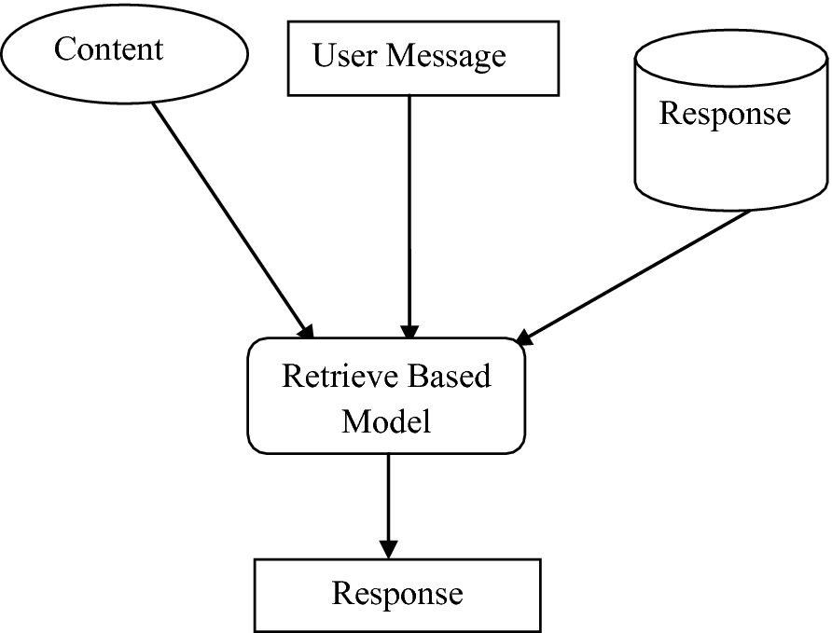
Block Diagram / Methodology
Block diagram of voice interactive system

Slide 8
Software and Hardware Requirements
Software Requirements
Windows 7,8,10 (32/64 bit)
Hardware Requirements
32 GB RAM 8 Octa Core Processor 500 GB hard disk space. Ensure C: drive has 100 GB plus free hard disk space.
Programming Languages
C++

Slide 9
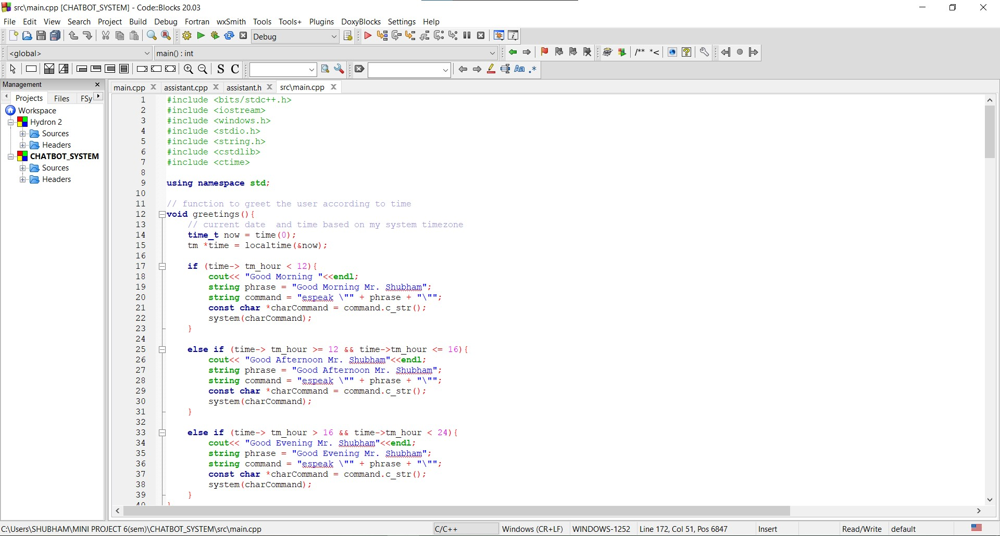
PROGRAM OF THE PROJECT

Slide 10
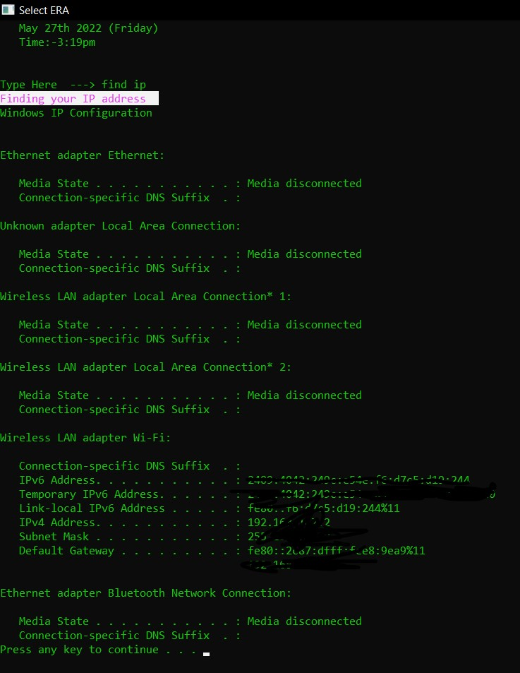
Expected Result

Slide 11
WORKDONE DONE TILL DATE
Till now we are work on our project to read the commands from user, and the chatbot is answering the user.
To enhance the ability of project. We have worked on our programming to recognized various types of commands.

Slide 12
References
List of websites refered for project
Bayan Abu Shawar and Eric Atwell, 2007 “Chatbots: Are they Really Useful?” : LDV Forum - GLDV Journal for Computational Linguistics and Language Technology. http://www.ldv-forum.org/2007_Heft1/Bayan_Abu-Shawar_and_Eric_Atwell.pdf
Kerly, A., Hall, P., and Bull, S. 2007. Bringing chatbots into education: Towards natural language negotiation of open learner models. Know.-Based Syst. 20, 2 (Mar. 2007), 177-185.
Lane, H.C. (2006). Intelligent Tutoring Systems: Prospects for Guided Practice and Efficient Learning. Whitepaper for the Army's Science of Learning Workshop, Hampton, VA. Aug 1-3, 2006.
http://en.wikipedia.org/wiki/Chatterbot
ALICE. 2002. A.L.I.C.E AI Foundation, http://www.alicebot.org/

Slide 13
Thank you !

